Slide 1



AWS-Certified DevOps Engineer Professional Course (DOP-C01)
Not for distribution ⒸStelleCloud
Not for distribution ⒸStelleCloud
www.stellecloud.com
www.corvit.com
www.stellecloud.com
www.corvit.com

Slide 2
Disclaimer: These slides are copyrighted and strictly for personal use only
This document is reserved for people enrolled into the StelleCloud AWS DevOps Course
Please do not share this document, it is intended for personal use and exam preparation only, thank you.
If you’ve obtained these slides for free on a website or a contact that is not the course’s website, please reach out to info@stellecloud.com Thanks!
Best of luck for the exam and happy learning!
Not for distribution ⒸStelleCloud
www.stellecloud.com
www.corvit.com

Slide 3
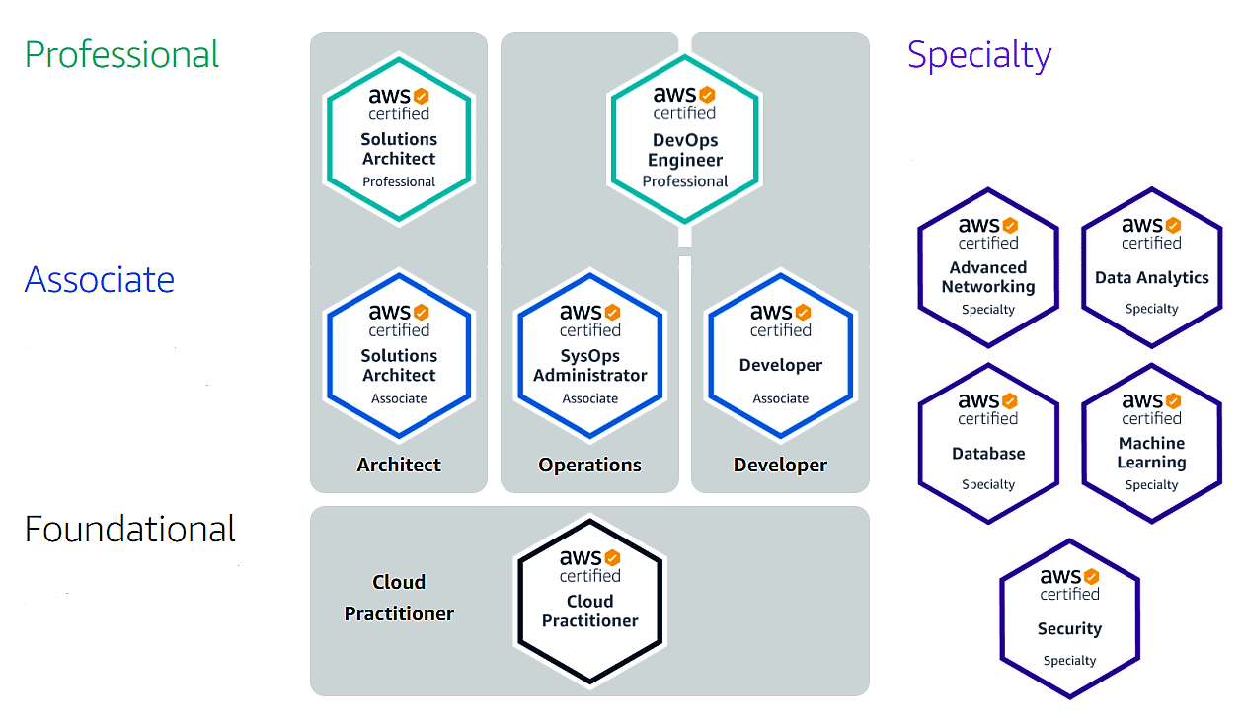
Not for distribution ⒸStelleCloud
www.stellecloud.com
www.corvit.com

Slide 4

Not for distribution ⒸStelleCloud
www.stellecloud.com
www.corvit.com

Slide 5
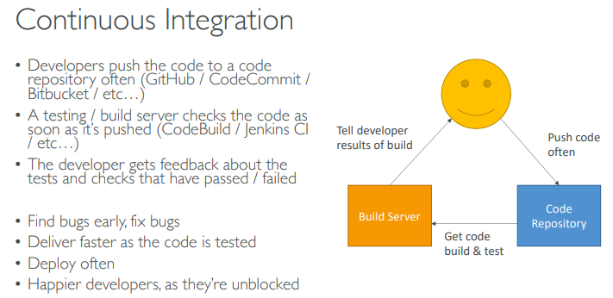
Not for distribution ⒸStelleCloud
www.stellecloud.com
www.corvit.com

Slide 6
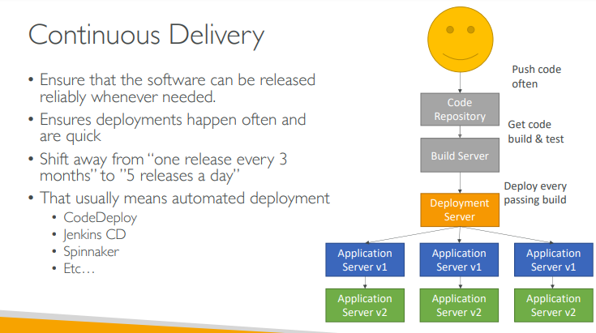

Not for distribution ⒸStelleCloud
www.stellecloud.com
www.corvit.com

Slide 7
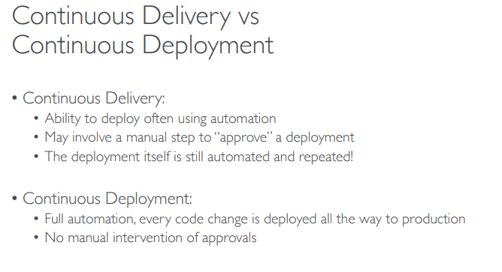
Not for distribution ⒸStelleCloud
www.stellecloud.com
www.corvit.com

Slide 8
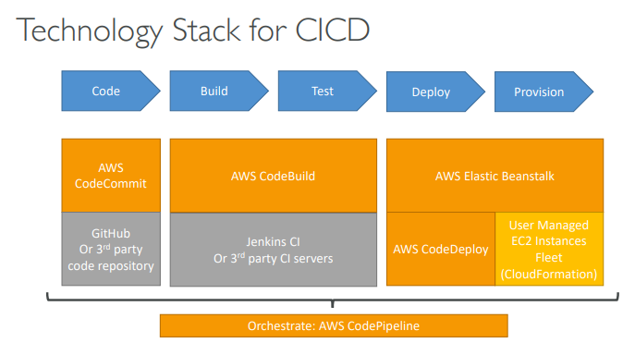
Not for distribution ⒸStelleCloud
www.stellecloud.com
www.corvit.com

Slide 9
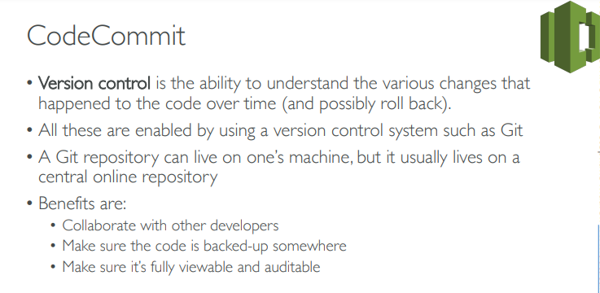
Not for distribution ⒸStelleCloud
www.stellecloud.com
www.corvit.com

Slide 10
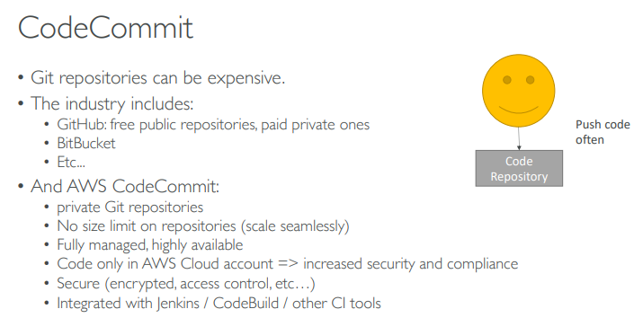
Not for distribution ⒸStelleCloud
www.stellecloud.com
www.corvit.com

Slide 11
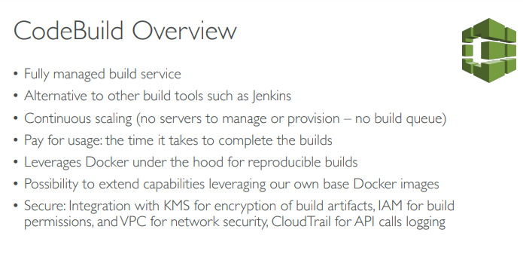
Not for distribution ⒸStelleCloud
www.stellecloud.com
www.corvit.com

Slide 12
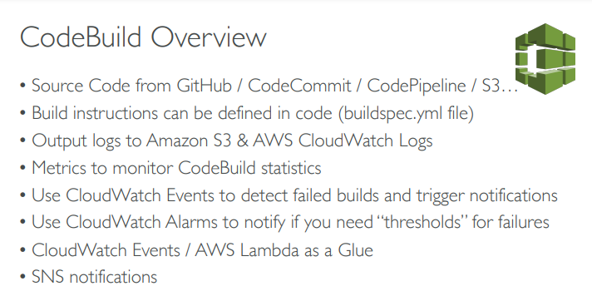
Not for distribution ⒸStelleCloud
www.stellecloud.com
www.corvit.com

Slide 13
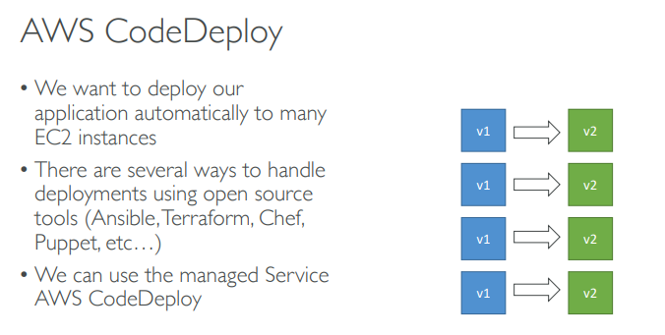
Not for distribution ⒸStelleCloud
www.stellecloud.com
www.corvit.com

Slide 14
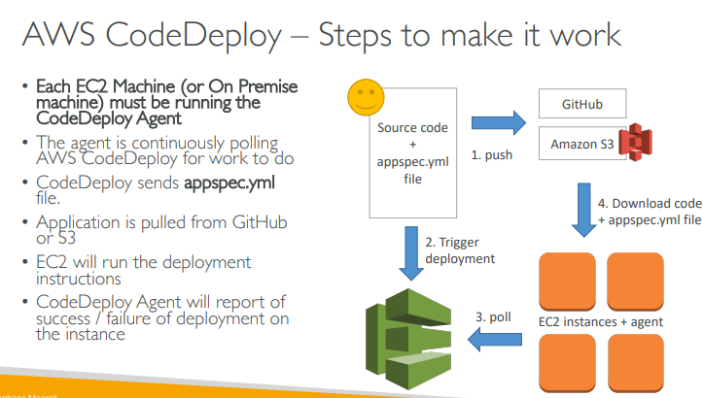


Not for distribution ⒸStelleCloud
www.stellecloud.com
www.corvit.com

Slide 15
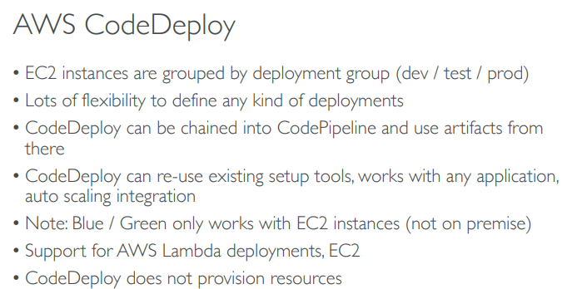
Not for distribution ⒸStelleCloud
www.stellecloud.com
www.corvit.com

Slide 16
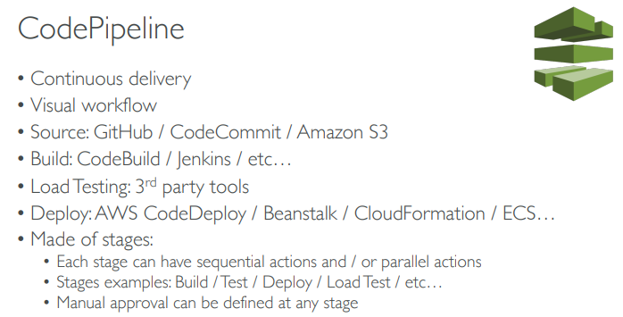
Not for distribution ⒸStelleCloud
www.stellecloud.com
www.corvit.com

Slide 17
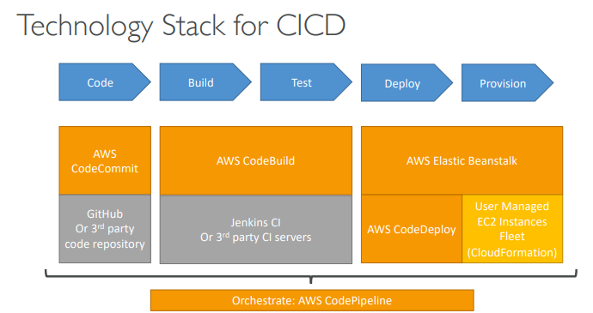
Not for distribution ⒸStelleCloud
www.stellecloud.com
www.corvit.com

Slide 18
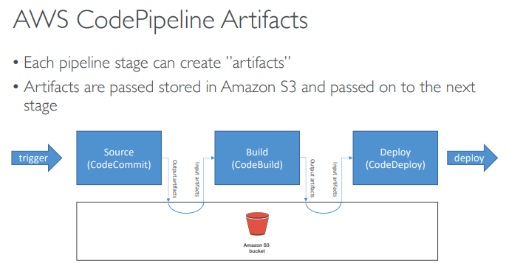
Not for distribution ⒸStelleCloud
www.stellecloud.com
www.corvit.com

Slide 19
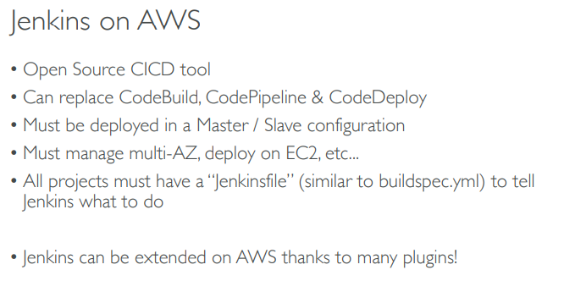
Not for distribution ⒸStelleCloud
www.stellecloud.com
www.corvit.com

Slide 20
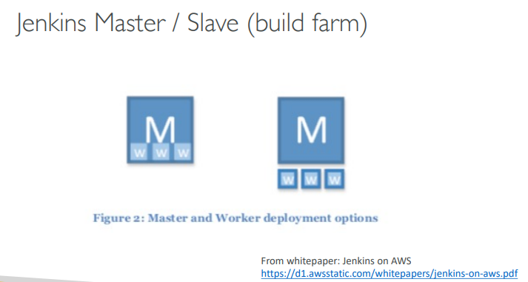

Not for distribution ⒸStelleCloud
www.stellecloud.com
www.corvit.com

Slide 21
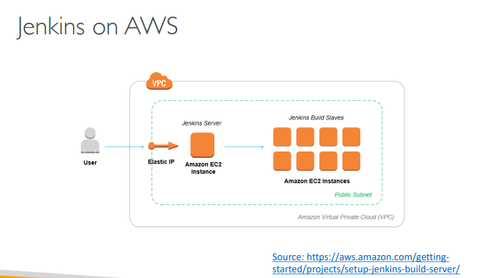

Not for distribution ⒸStelleCloud
www.stellecloud.com
www.corvit.com

Slide 22
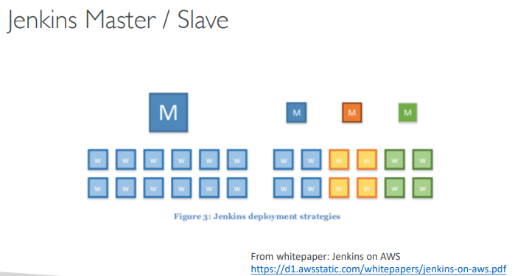
Not for distribution ⒸStelleCloud
www.stellecloud.com
www.corvit.com

Slide 23
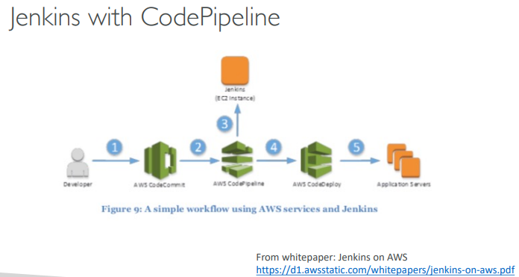

Not for distribution ⒸStelleCloud
www.stellecloud.com
www.corvit.com

Slide 24
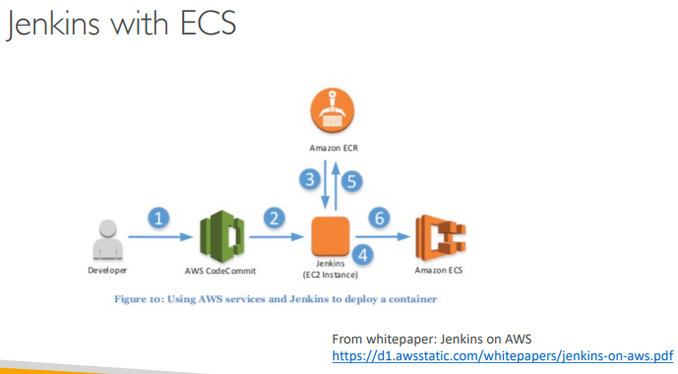

Not for distribution ⒸStelleCloud
www.stellecloud.com
www.corvit.com

Slide 25
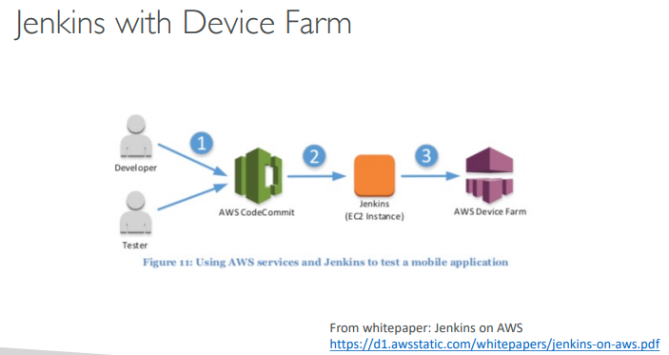

Not for distribution ⒸStelleCloud
www.stellecloud.com
www.corvit.com

Slide 26
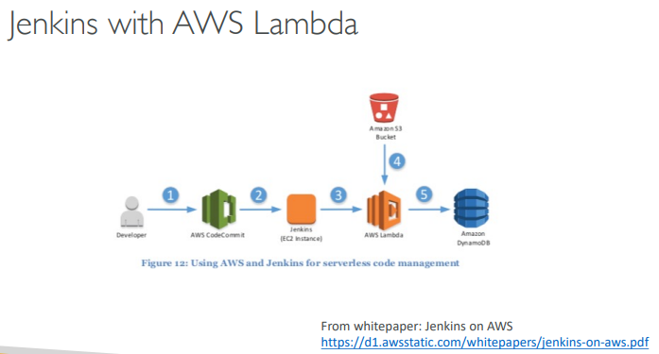

Not for distribution ⒸStelleCloud
www.stellecloud.com
www.corvit.com

Slide 27
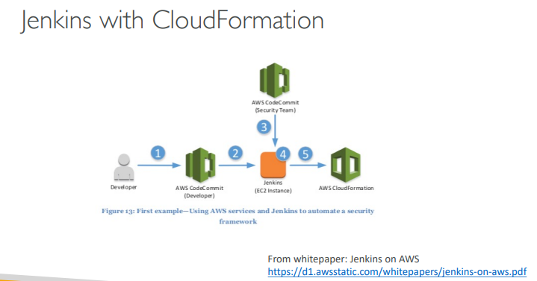

Not for distribution ⒸStelleCloud
www.stellecloud.com
www.corvit.com

Slide 28
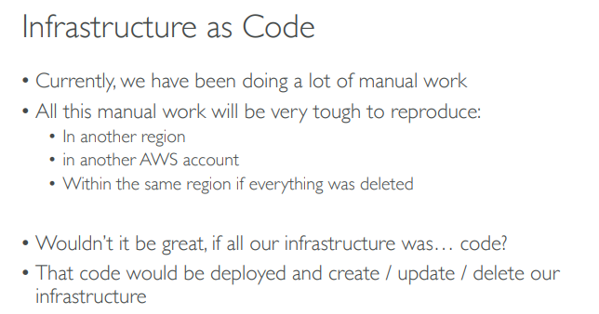
Not for distribution ⒸStelleCloud
www.stellecloud.com
www.corvit.com

Slide 29
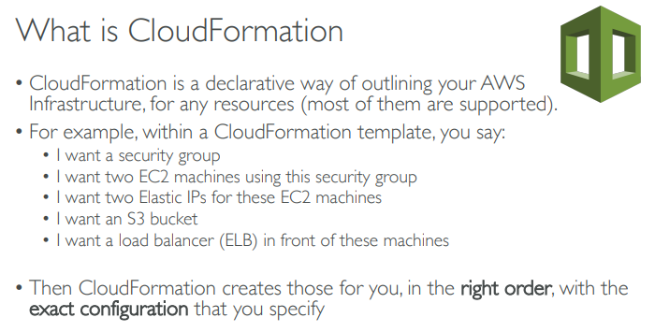
Not for distribution ⒸStelleCloud
www.stellecloud.com
www.corvit.com

Slide 30
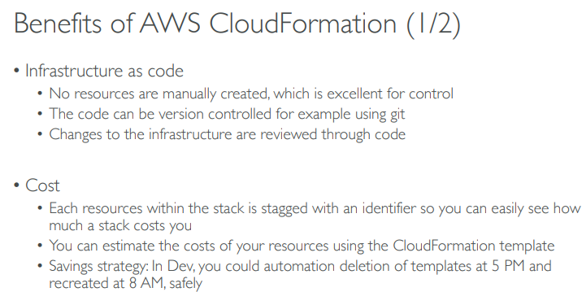
Not for distribution ⒸStelleCloud
www.stellecloud.com
www.corvit.com

Slide 31
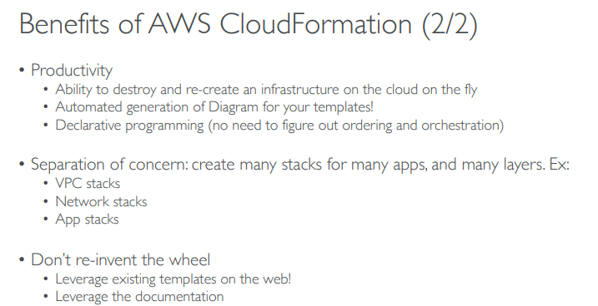
Not for distribution ⒸStelleCloud
www.stellecloud.com
www.corvit.com

Slide 32
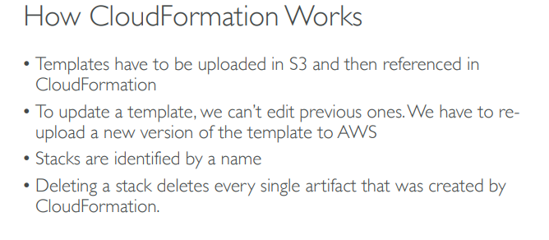
Not for distribution ⒸStelleCloud
www.stellecloud.com
www.corvit.com

Slide 33
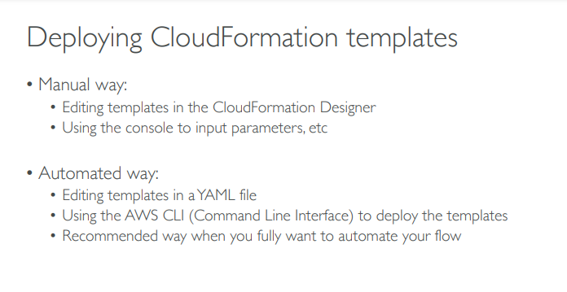
Not for distribution ⒸStelleCloud
www.stellecloud.com
www.corvit.com

Slide 34
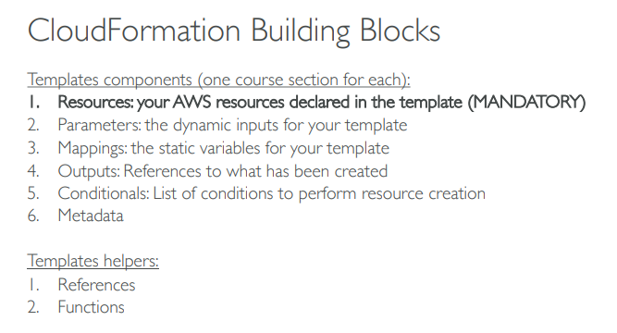
Not for distribution ⒸStelleCloud
www.stellecloud.com
www.corvit.com

Slide 35
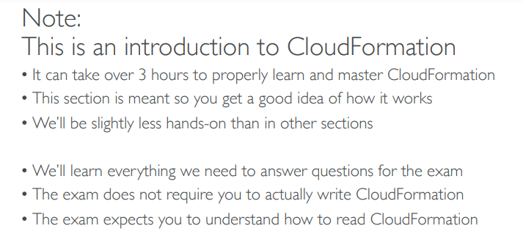
Not for distribution ⒸStelleCloud
www.stellecloud.com
www.corvit.com

Slide 36
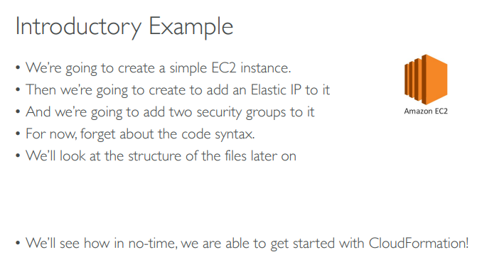
Not for distribution ⒸStelleCloud
www.stellecloud.com
www.corvit.com

Slide 37
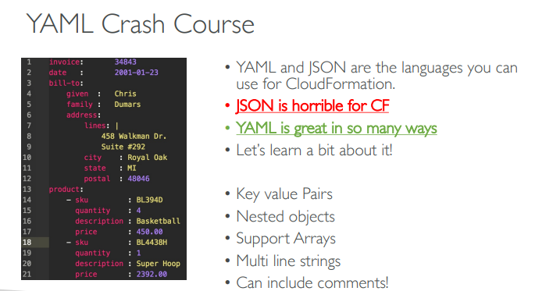
Not for distribution ⒸStelleCloud
www.stellecloud.com
www.corvit.com

Slide 38
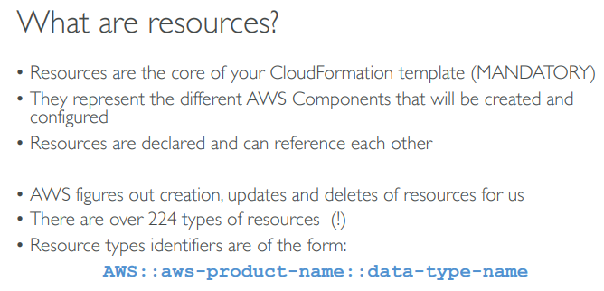
Not for distribution ⒸStelleCloud
www.stellecloud.com
www.corvit.com

Slide 39
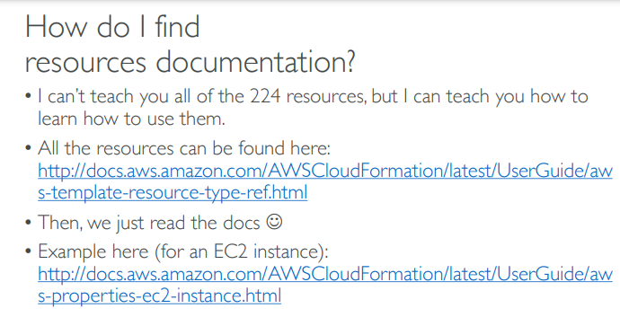
Not for distribution ⒸStelleCloud
www.stellecloud.com
www.corvit.com

Slide 40
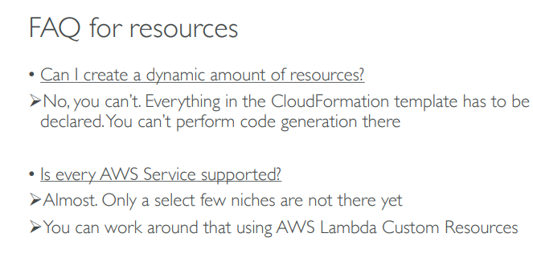
Not for distribution ⒸStelleCloud
www.stellecloud.com
www.corvit.com

Slide 41
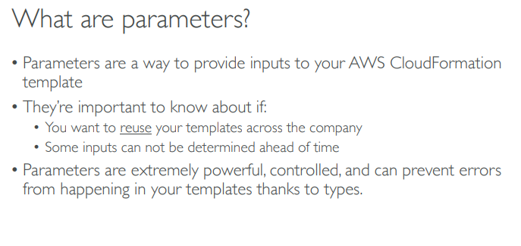
Not for distribution ⒸStelleCloud
www.stellecloud.com
www.corvit.com

Slide 42
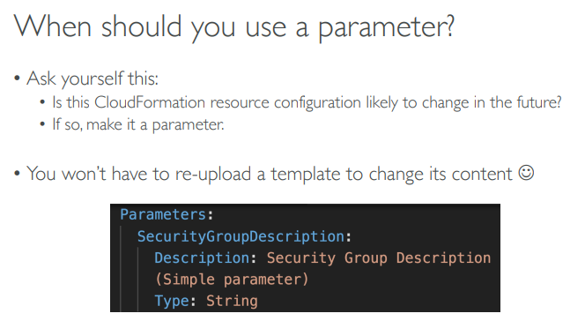
Not for distribution ⒸStelleCloud
www.stellecloud.com
www.corvit.com

Slide 43
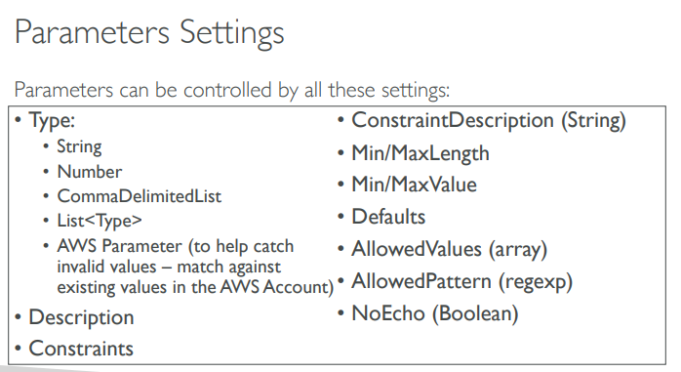
Not for distribution ⒸStelleCloud
www.stellecloud.com
www.corvit.com

Slide 44
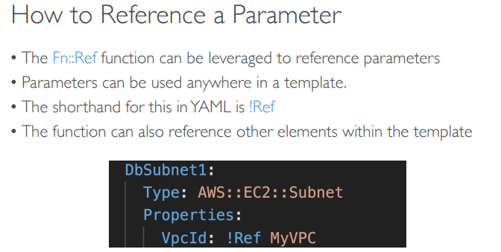
Not for distribution ⒸStelleCloud
www.stellecloud.com
www.corvit.com

Slide 45
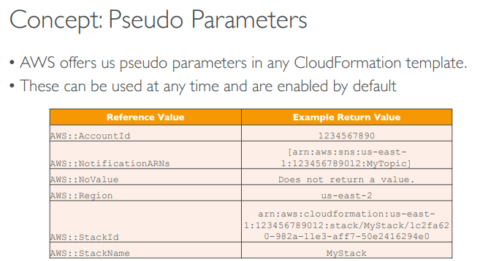
Not for distribution ⒸStelleCloud
www.stellecloud.com
www.corvit.com

Slide 46
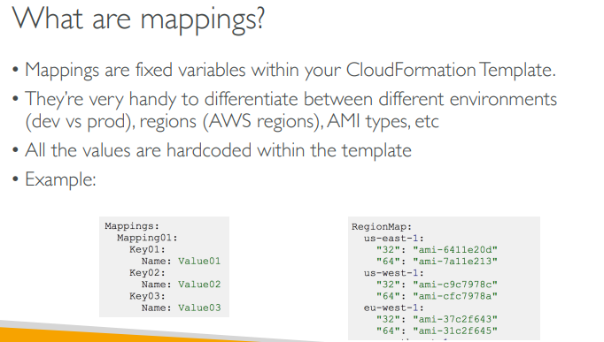

Not for distribution ⒸStelleCloud
www.stellecloud.com
www.corvit.com

Slide 47
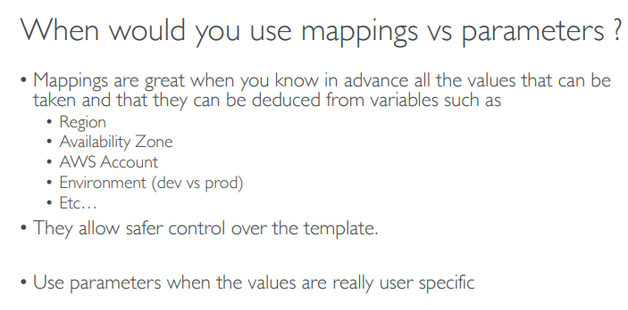
Not for distribution ⒸStelleCloud
www.stellecloud.com
www.corvit.com

Slide 48
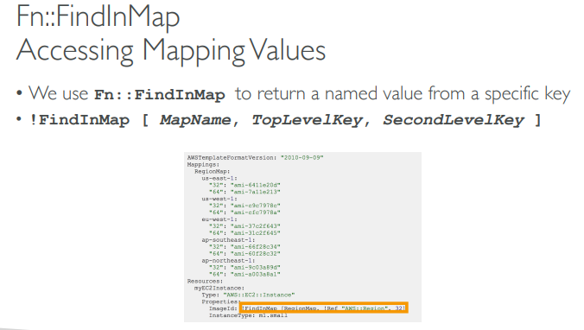
Not for distribution ⒸStelleCloud
www.stellecloud.com
www.corvit.com

Slide 49
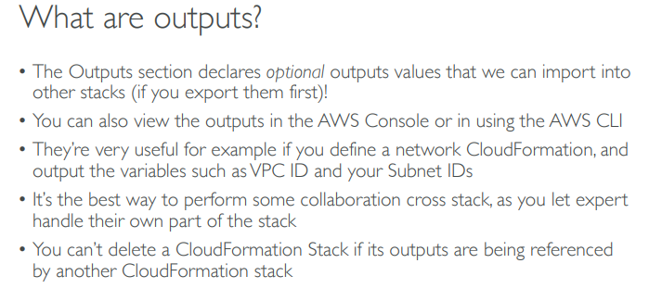
Not for distribution ⒸStelleCloud
www.stellecloud.com
www.corvit.com

Slide 50
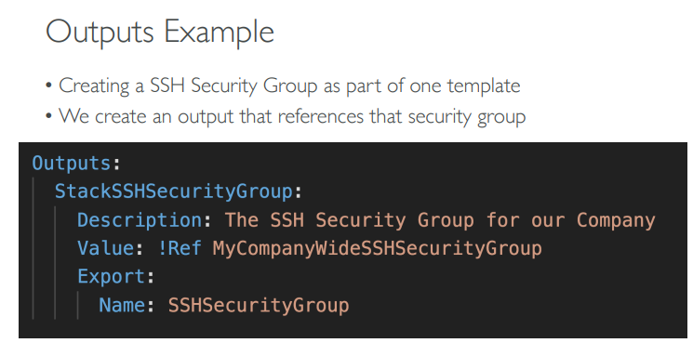
Not for distribution ⒸStelleCloud
www.stellecloud.com
www.corvit.com

Slide 51
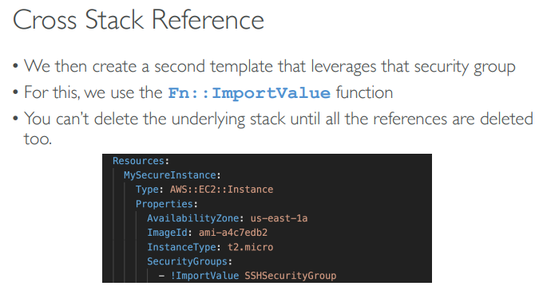
Not for distribution ⒸStelleCloud
www.stellecloud.com
www.corvit.com

Slide 52
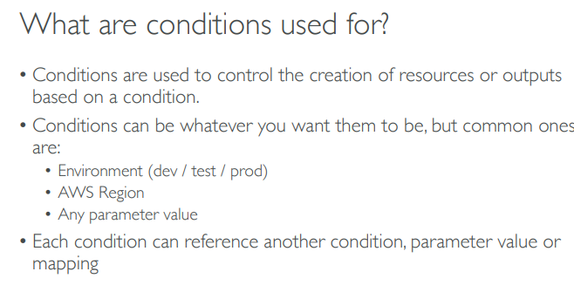
Not for distribution ⒸStelleCloud
www.stellecloud.com
www.corvit.com

Slide 53
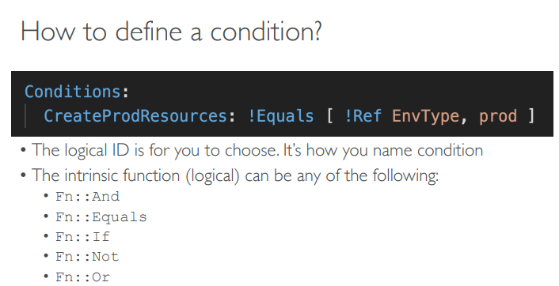
Not for distribution ⒸStelleCloud
www.stellecloud.com
www.corvit.com

Slide 54

Not for distribution ⒸStelleCloud
www.stellecloud.com
www.corvit.com

Slide 55

Not for distribution ⒸStelleCloud
www.stellecloud.com
www.corvit.com

Slide 56

Not for distribution ⒸStelleCloud
www.stellecloud.com
www.corvit.com

Slide 57

Not for distribution ⒸStelleCloud
www.stellecloud.com
www.corvit.com

Slide 58

Not for distribution ⒸStelleCloud
www.stellecloud.com
www.corvit.com

Slide 59

Not for distribution ⒸStelleCloud
www.stellecloud.com
www.corvit.com

Slide 60

Not for distribution ⒸStelleCloud
www.stellecloud.com
www.corvit.com

Slide 61

Not for distribution ⒸStelleCloud
www.stellecloud.com
www.corvit.com

Slide 62

Not for distribution ⒸStelleCloud
www.stellecloud.com
www.corvit.com

Slide 63

Not for distribution ⒸStelleCloud
www.stellecloud.com
www.corvit.com

Slide 64


Not for distribution ⒸStelleCloud
www.stellecloud.com
www.corvit.com

Slide 65

Not for distribution ⒸStelleCloud
www.stellecloud.com
www.corvit.com

Slide 66

Not for distribution ⒸStelleCloud
www.stellecloud.com
www.corvit.com

Slide 67

Not for distribution ⒸStelleCloud
www.stellecloud.com
www.corvit.com

Slide 68

Not for distribution ⒸStelleCloud
www.stellecloud.com
www.corvit.com

Slide 69


Not for distribution ⒸStelleCloud
www.stellecloud.com
www.corvit.com

Slide 70

Not for distribution ⒸStelleCloud
www.stellecloud.com
www.corvit.com

Slide 71

Not for distribution ⒸStelleCloud
www.stellecloud.com
www.corvit.com

Slide 72


Not for distribution ⒸStelleCloud
www.stellecloud.com
www.corvit.com

Slide 73

Not for distribution ⒸStelleCloud
www.stellecloud.com
www.corvit.com

Slide 74

Not for distribution ⒸStelleCloud
www.stellecloud.com
www.corvit.com

Slide 75

Not for distribution ⒸStelleCloud
www.stellecloud.com
www.corvit.com

Slide 76

Not for distribution ⒸStelleCloud
www.stellecloud.com
www.corvit.com

Slide 77

Not for distribution ⒸStelleCloud
www.stellecloud.com
www.corvit.com

Slide 78

Not for distribution ⒸStelleCloud
www.stellecloud.com
www.corvit.com

Slide 79


Not for distribution ⒸStelleCloud
www.stellecloud.com
www.corvit.com

Slide 80



Not for distribution ⒸStelleCloud
www.stellecloud.com
www.corvit.com

Slide 81

Not for distribution ⒸStelleCloud
www.stellecloud.com
www.corvit.com

Slide 82

Not for distribution ⒸStelleCloud
www.stellecloud.com
www.corvit.com

Slide 83

Not for distribution ⒸStelleCloud
www.stellecloud.com
www.corvit.com

Slide 84

Not for distribution ⒸStelleCloud
www.stellecloud.com
www.corvit.com

Slide 85

Not for distribution ⒸStelleCloud
www.stellecloud.com
www.corvit.com

Slide 86

Not for distribution ⒸStelleCloud
www.stellecloud.com
www.corvit.com

Slide 87


Not for distribution ⒸStelleCloud
www.stellecloud.com
www.corvit.com

Slide 88

Not for distribution ⒸStelleCloud
www.stellecloud.com
www.corvit.com

Slide 89

Not for distribution ⒸStelleCloud
www.stellecloud.com
www.corvit.com

Slide 90

Not for distribution ⒸStelleCloud
www.stellecloud.com
www.corvit.com

Slide 91


Not for distribution ⒸStelleCloud
www.stellecloud.com
www.corvit.com

Slide 92

Not for distribution ⒸStelleCloud
www.stellecloud.com
www.corvit.com

Slide 93

Not for distribution ⒸStelleCloud
www.stellecloud.com
www.corvit.com

Slide 94


Not for distribution ⒸStelleCloud
www.stellecloud.com
www.corvit.com

Slide 95

Not for distribution ⒸStelleCloud
www.stellecloud.com
www.corvit.com

Slide 96

Not for distribution ⒸStelleCloud
www.stellecloud.com
www.corvit.com

Slide 97

Not for distribution ⒸStelleCloud
www.stellecloud.com
www.corvit.com

Slide 98

Not for distribution ⒸStelleCloud
www.stellecloud.com
www.corvit.com

Slide 99


Not for distribution ⒸStelleCloud
www.stellecloud.com
www.corvit.com

Slide 100

Not for distribution ⒸStelleCloud
www.stellecloud.com
www.corvit.com

Slide 101

Not for distribution ⒸStelleCloud
www.stellecloud.com
www.corvit.com

Slide 102

Not for distribution ⒸStelleCloud
www.stellecloud.com
www.corvit.com

Slide 103

Not for distribution ⒸStelleCloud
www.stellecloud.com
www.corvit.com

Slide 104

Not for distribution ⒸStelleCloud
www.stellecloud.com
www.corvit.com

Slide 105

Not for distribution ⒸStelleCloud
www.stellecloud.com
www.corvit.com

Slide 106

Not for distribution ⒸStelleCloud
www.stellecloud.com
www.corvit.com

Slide 107

Not for distribution ⒸStelleCloud
www.stellecloud.com
www.corvit.com

Slide 108

Not for distribution ⒸStelleCloud
www.stellecloud.com
www.corvit.com

Slide 109

Not for distribution ⒸStelleCloud
www.stellecloud.com
www.corvit.com

Slide 110


Not for distribution ⒸStelleCloud
www.stellecloud.com
www.corvit.com

Slide 111


Not for distribution ⒸStelleCloud
www.stellecloud.com
www.corvit.com

Slide 112

Not for distribution ⒸStelleCloud
www.stellecloud.com
www.corvit.com

Slide 113

Not for distribution ⒸStelleCloud
www.stellecloud.com
www.corvit.com

Slide 114

Not for distribution ⒸStelleCloud
www.stellecloud.com
www.corvit.com

Slide 115

Not for distribution ⒸStelleCloud
www.stellecloud.com
www.corvit.com

Slide 116

Not for distribution ⒸStelleCloud
www.stellecloud.com
www.corvit.com

Slide 117

Not for distribution ⒸStelleCloud
www.stellecloud.com
www.corvit.com

Slide 118

Not for distribution ⒸStelleCloud
www.stellecloud.com
www.corvit.com

Slide 119

Not for distribution ⒸStelleCloud
www.stellecloud.com
www.corvit.com

Slide 120

Not for distribution ⒸStelleCloud
www.stellecloud.com
www.corvit.com

Slide 121

Not for distribution ⒸStelleCloud
www.stellecloud.com
www.corvit.com

Slide 122

Not for distribution ⒸStelleCloud
www.stellecloud.com
www.corvit.com

Slide 123

Not for distribution ⒸStelleCloud
www.stellecloud.com
www.corvit.com

Slide 124

Not for distribution ⒸStelleCloud
www.stellecloud.com
www.corvit.com

Slide 125

Not for distribution ⒸStelleCloud
www.stellecloud.com
www.corvit.com

Slide 126

Not for distribution ⒸStelleCloud
www.stellecloud.com
www.corvit.com

Slide 127

Not for distribution ⒸStelleCloud
www.stellecloud.com
www.corvit.com

Slide 128


Not for distribution ⒸStelleCloud
www.stellecloud.com
www.corvit.com

Slide 129

Not for distribution ⒸStelleCloud
www.stellecloud.com
www.corvit.com

Slide 130

Not for distribution ⒸStelleCloud
www.stellecloud.com
www.corvit.com

Slide 131

Not for distribution ⒸStelleCloud
www.stellecloud.com
www.corvit.com

Slide 132

Not for distribution ⒸStelleCloud
www.stellecloud.com
www.corvit.com

Slide 133

Not for distribution ⒸStelleCloud
www.stellecloud.com
www.corvit.com

Slide 134

Not for distribution ⒸStelleCloud
www.stellecloud.com
www.corvit.com

Slide 135

Not for distribution ⒸStelleCloud
www.stellecloud.com
www.corvit.com

Slide 136

Not for distribution ⒸStelleCloud
www.stellecloud.com
www.corvit.com

Slide 137

Not for distribution ⒸStelleCloud
www.stellecloud.com
www.corvit.com

Slide 138

Not for distribution ⒸStelleCloud
www.stellecloud.com
www.corvit.com

Slide 139

Not for distribution ⒸStelleCloud
www.stellecloud.com
www.corvit.com

Slide 140

Not for distribution ⒸStelleCloud
www.stellecloud.com
www.corvit.com

Slide 141

Not for distribution ⒸStelleCloud
www.stellecloud.com
www.corvit.com

Slide 142

Not for distribution ⒸStelleCloud
www.stellecloud.com
www.corvit.com

Slide 143

Not for distribution ⒸStelleCloud
www.stellecloud.com
www.corvit.com

Slide 144

Not for distribution ⒸStelleCloud
www.stellecloud.com
www.corvit.com

Slide 145

Not for distribution ⒸStelleCloud
www.stellecloud.com
www.corvit.com

Slide 146

Not for distribution ⒸStelleCloud
www.stellecloud.com
www.corvit.com

Slide 147

Not for distribution ⒸStelleCloud
www.stellecloud.com
www.corvit.com

Slide 148

Not for distribution ⒸStelleCloud
www.stellecloud.com
www.corvit.com

Slide 149

Not for distribution ⒸStelleCloud
www.stellecloud.com
www.corvit.com

Slide 150

Not for distribution ⒸStelleCloud
www.stellecloud.com
www.corvit.com

Slide 151

Not for distribution ⒸStelleCloud
www.stellecloud.com
www.corvit.com

Slide 152

Not for distribution ⒸStelleCloud
www.stellecloud.com
www.corvit.com

Slide 153

Not for distribution ⒸStelleCloud
www.stellecloud.com
www.corvit.com

Slide 154

Not for distribution ⒸStelleCloud
www.stellecloud.com
www.corvit.com

Slide 155

Not for distribution ⒸStelleCloud
www.stellecloud.com
www.corvit.com

Slide 156

Not for distribution ⒸStelleCloud
www.stellecloud.com
www.corvit.com

Slide 157

Not for distribution ⒸStelleCloud
www.stellecloud.com
www.corvit.com

Slide 158

Not for distribution ⒸStelleCloud
www.stellecloud.com
www.corvit.com

Slide 159

Not for distribution ⒸStelleCloud
www.stellecloud.com
www.corvit.com

Slide 160

Not for distribution ⒸStelleCloud
www.stellecloud.com
www.corvit.com

Slide 161

Not for distribution ⒸStelleCloud
www.stellecloud.com
www.corvit.com

Slide 162

Not for distribution ⒸStelleCloud
www.stellecloud.com
www.corvit.com

Slide 163

Not for distribution ⒸStelleCloud
www.stellecloud.com
www.corvit.com

Slide 164

Not for distribution ⒸStelleCloud
www.stellecloud.com
www.corvit.com

Slide 165

Not for distribution ⒸStelleCloud
www.stellecloud.com
www.corvit.com

Slide 166


Not for distribution ⒸStelleCloud
www.stellecloud.com
www.corvit.com

Slide 167


Not for distribution ⒸStelleCloud
www.stellecloud.com
www.corvit.com

Slide 168


Not for distribution ⒸStelleCloud
www.stellecloud.com
www.corvit.com

Slide 169

Not for distribution ⒸStelleCloud
www.stellecloud.com
www.corvit.com

Slide 170

Not for distribution ⒸStelleCloud
www.stellecloud.com
www.corvit.com

Slide 171

Not for distribution ⒸStelleCloud
www.stellecloud.com
www.corvit.com

Slide 172

Not for distribution ⒸStelleCloud
www.stellecloud.com
www.corvit.com

Slide 173


Not for distribution ⒸStelleCloud
www.stellecloud.com
www.corvit.com

Slide 174


Not for distribution ⒸStelleCloud
www.stellecloud.com
www.corvit.com

Slide 175

Not for distribution ⒸStelleCloud
www.stellecloud.com
www.corvit.com

Slide 176
Not for distribution ⒸStelleCloud
www.stellecloud.com
www.corvit.com

